Slide 1
RESEARCH ELECTRIC COMPANY., LTD

Slide 2
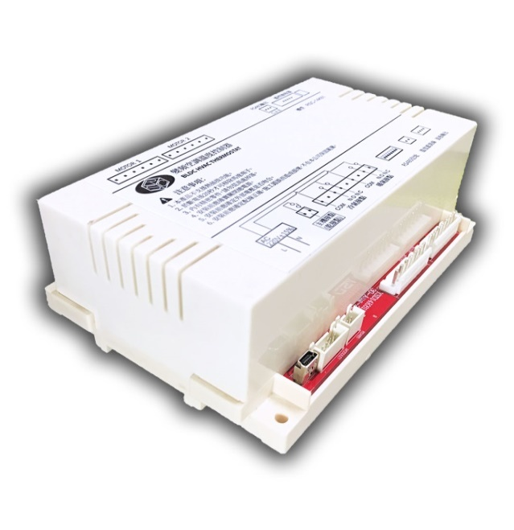
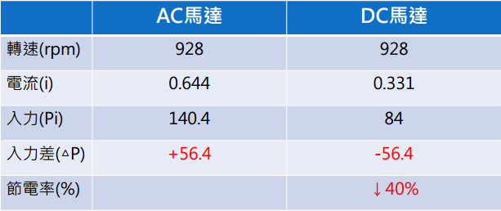
ＴＥＣＨＮＩＣＡＬ ＳＹＳＴＥＭ
BLDC Thermostat
＞
＞
＞
WATER CHILLER UNIT WITH FLOOR CONTROL
Supporting Water chiller units and floor control systems.
Supporting maximum 255sets fan coil unit, pairing with RS485 systems (Expandable).
Build-in design with dual output terminals, supporting 1200seris above fan coil units.
DLBC motors reduce 60% power consumption compare with normal AC motors (800series)
＞
＞
＞
SINGLE UNIT WITH DUAL-OUTPUT PAIR WITH DLBC MOTORS

Slide 3
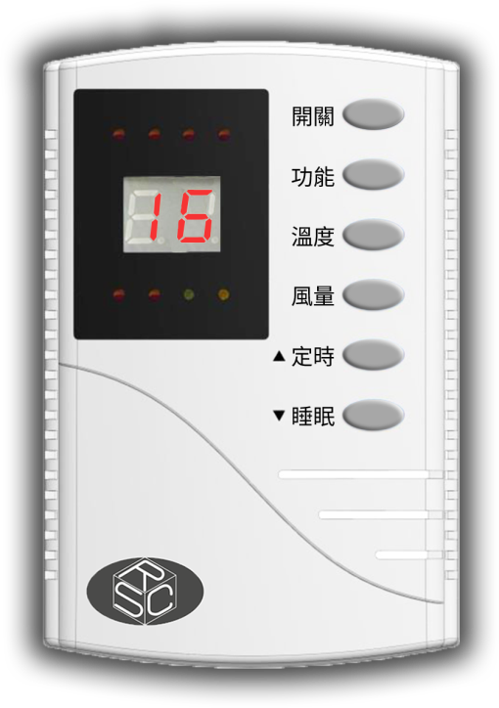
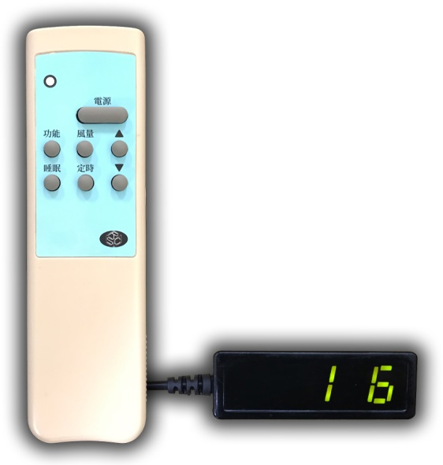
CONTROL SYSTEM
Theory of Business
PROVIDE DIVERSIFIED CONTROL –SYSTEM OPTIONS
＞
＞
＞
WIRED PANEL
Clean display
Stable wire transit up to 20 meters length.
Easy
Fast installation with only 4 wires cable and easy to repair.
＞
＞
＞
WIRELESS REMOTE／RECEIVER
ECONOMIC
No wire cable for installation. Reduce the cost for clients.
SIMPLIFY
Combination display & receiver with one module .

Slide 4
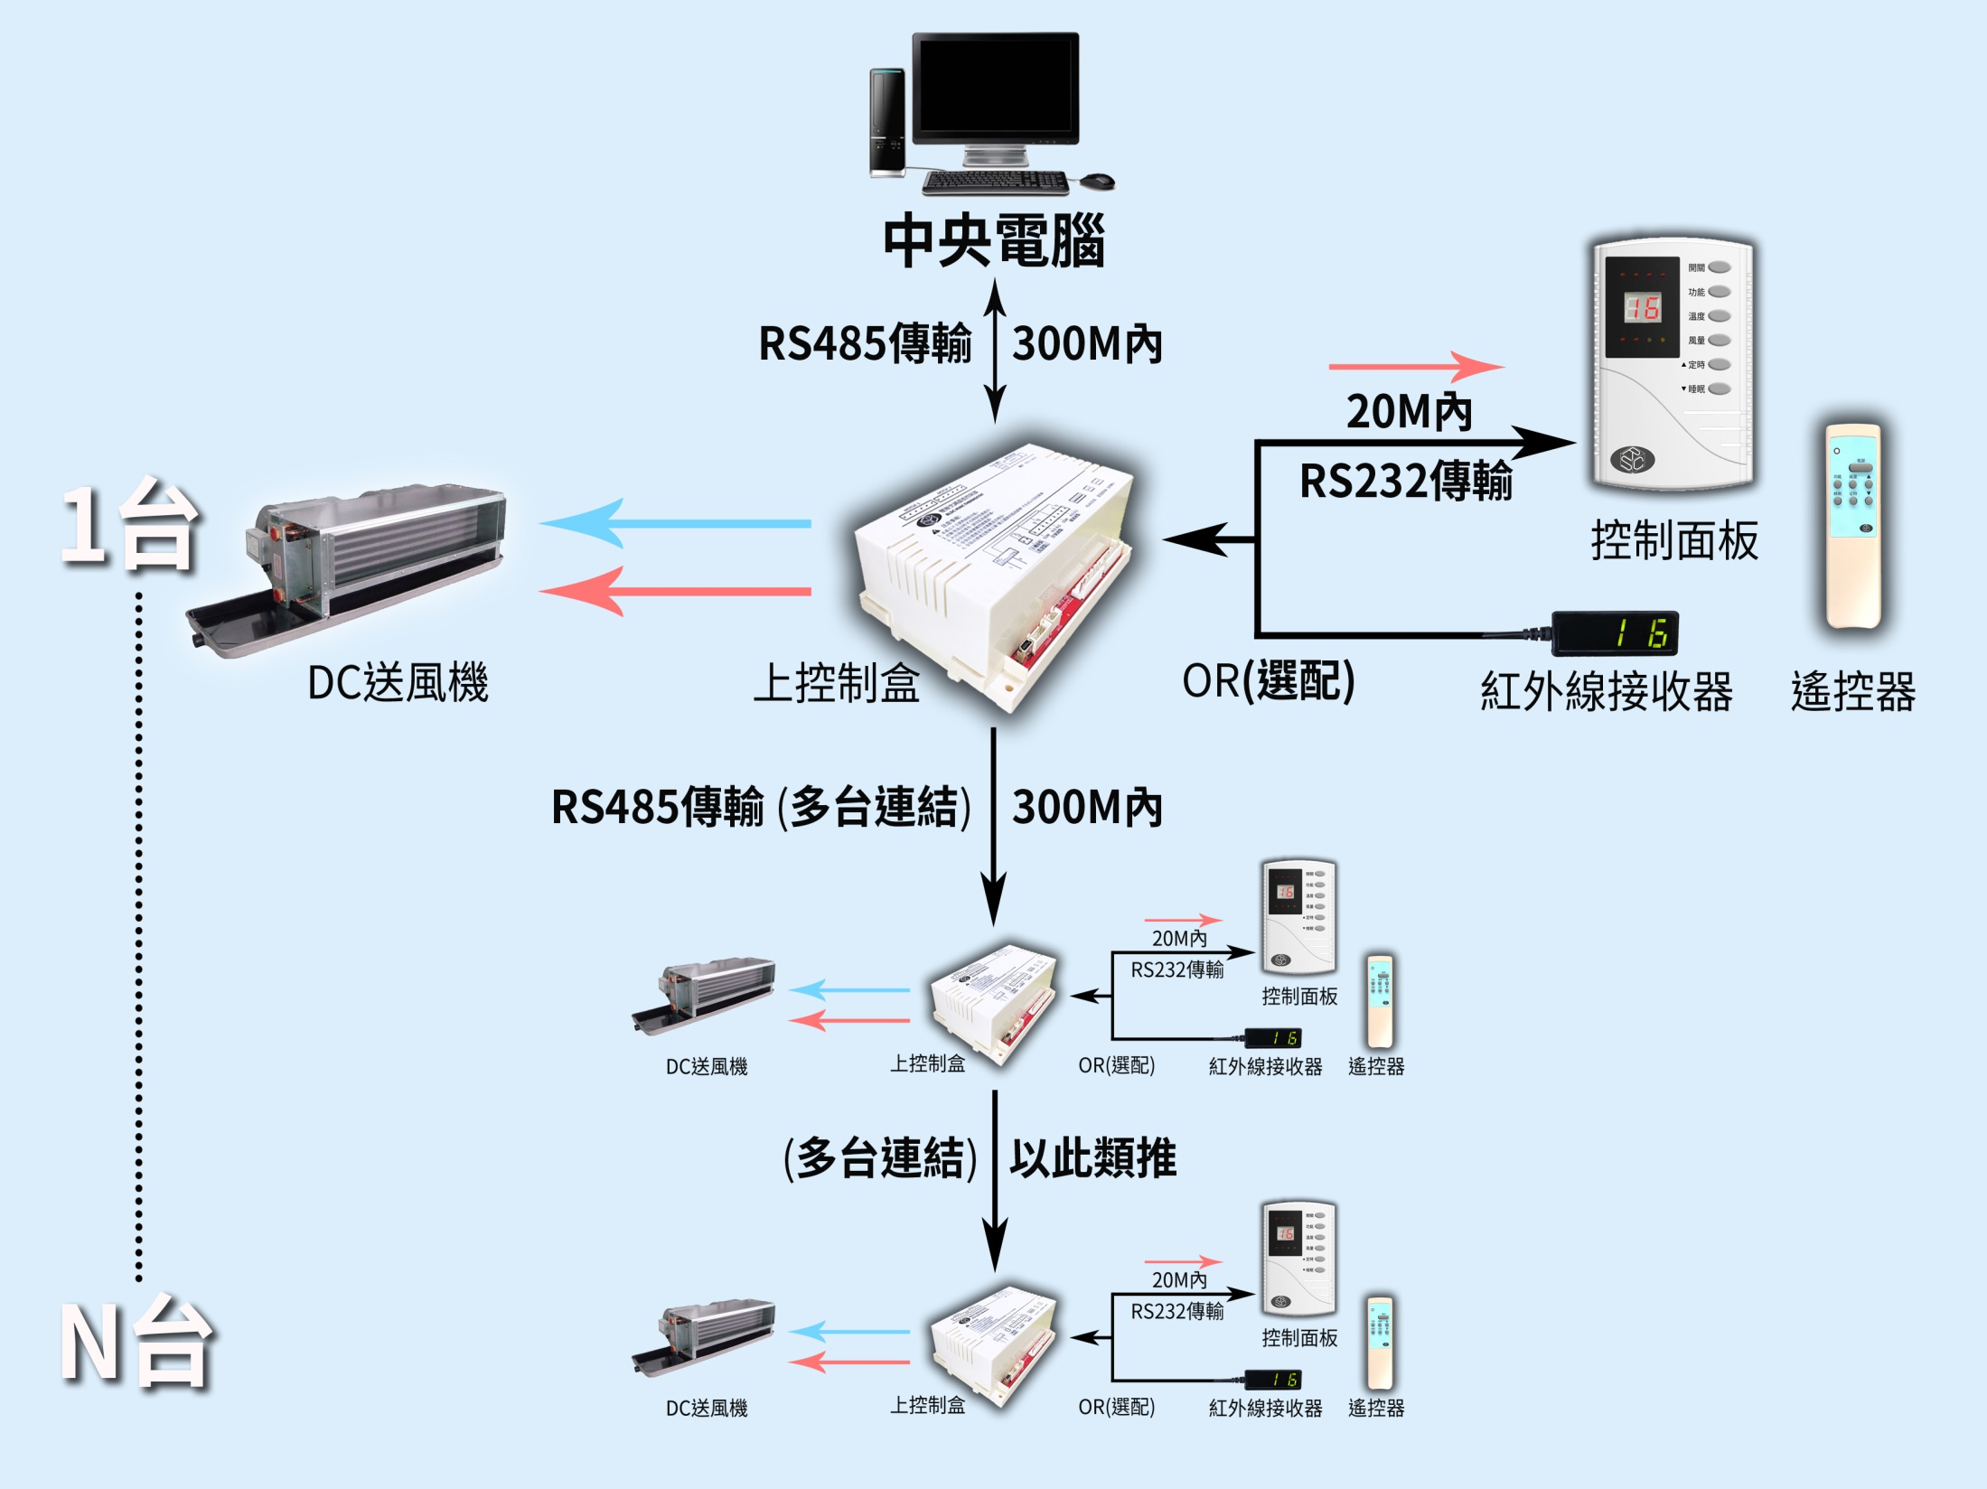

Slide 5
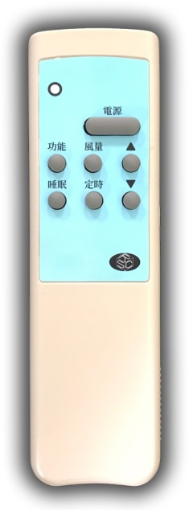
FUNCTION MANUAL
FUNCTIONS
OPERTING SETTINGS
ON/OFF BUTTON
Display current Temp, when boot with double buzzer sound.
FUNCTION BUTTON
4 modes supports: Heat, cold, Fan, dehumidifier.
SETTING BUTTON
Press button till LED flashing, and press UP/DOWN button for Temp. setting
Setting range: 16~30℃
SPEED BUTTON
4 options for speed control: AUTO , HIGH, MID, LOW (fine-tune for each speed)。
TIMER BUTTON(UP)
Timer support to power on and off; up to 16 hours. (LED light on)
SLEEP BUTTON(DOWN)
AUTO fan Speed when it on.

Slide 6
AC/DC馬逹S-T特性分析
800型 高靜壓 比較分析
 | AC馬達 |  | DC馬達
靜壓值 | 0MM | 5MM | 0MM | 5MM
轉速(rpm) | 932 | 1070 | 932 | 1070
電流(A) | 0.647 | 0.521 | 0.433 | 0.378
入力(W) | 142.4 | 114.7 | 95.2 | 83.2
入力差(△W) | +0 | +0 | -47.2 | -31.5
節電率(%) |  |  | 67% | 72.5%

Slide 7
AC/DC馬逹S-T特性分析
600型 高靜壓 比較分析
 | AC馬達 |  | DC馬達
靜壓值 | 0MM | 5MM | 0MM | 5MM
轉速(rpm) | 865 | 1071 | 865 | 1071
電流(i) | 0.501 | 0.371 | 0.31 | 0.278
入力(Pi) | 108.4 | 81.6 | 68.4 | 61.3
入力差(△P) | +0 | +0 | -40 | -20.3
節電率(%) |  |  | 63% | 75%

Slide 8
AC/DC馬逹S-T特性分析
400型 高靜壓 比較分析
 | AC馬達 |  | DC馬達
靜壓值 | 0MM | 5MM | 0MM | 5MM
轉速(rpm) | 980 | 1070 | 980 | 1070
電流(i) | 0.398 | 0.344 | 0.27 | 0.247
入力(Pi) | 87.4 | 75.7 | 59.2 | 54.4
入力差(△P) | +0 | +0 | -28.2 | -31.3
節電率(%) |  |  | 67% | 72%

Slide 9
AC/DC馬逹S-T特性分析
300型 高靜壓 比較分析
 | AC馬達 |  | DC馬達
靜壓值 | 0MM | 5MM | 0MM | 5MM
轉速(rpm) | 880 | 1040 | 880 | 1040
電流(i) | 0.282 | 0.229 | 0.15 | 0.135
入力(Pi) | 60.7 | 49.6 | 33 | 30
入力差(△P) | +0 | +0 | -27.7 | -19.6
節電率(%) |  |  | 54.3% | 60%

